Slide 1
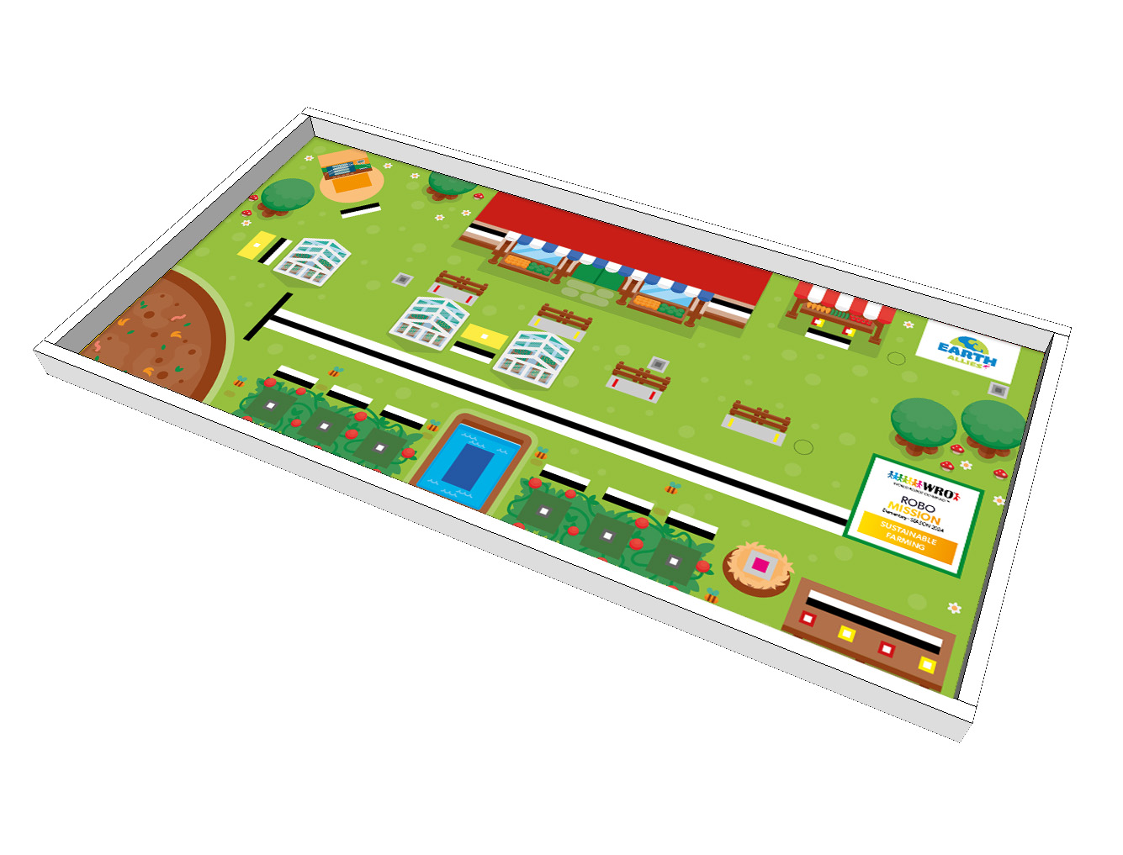
Greenhouses (with red / yellow vegetables)
Market
Vegetables (red or yellow)
Start Area
Compost
Green vegetables / Earth blocks
Vegetables (red and yellow)
Water Tower
Fence
Chicken

